Slide 1
Pointers
IN628 Intermediate Algorithms and Architectures
Session 1.2
Semester 2, 2016

Slide 2
Pointers
Pointers are used rarely in C# and not at all in Java.
Pointers are used a lot in C++.
All user-defined and system objects are handled via pointers.
Complex data structures (e.g. linked lists) rely heavily on pointers.
Notes:
So you have to learn them
And you need to understand them
To do that, we need to think about what’s really inside the computer...

Slide 3
Pointers
When you declare a simple variable (e.g. int myNum), it is assigned a memory location where its value will be stored
Memory Addresses
Memory
115
116
117
118
119
myNum will be stored here
Notes:
Note that addresses aren’t really small numbers like 117, they are big gigabytelike numbers
But the logic is the same, and it’s easier to talk about 117

Slide 4
Pointers
You can think of myNum as “the variable whose value is stored at address 117”.
Pointers are special variables that hold memory addresses.
If you declare a pointer and set its value to 117, it is “pointing at” the variable myNum.
You can use the pointer to observe and change the value of myNum (i.e. the value stored at memory location 117).
Notes:
Pointer variables can only ever hold (i.e. Have as its value) a memory address. The same way ints can only hold whole numbers, or a bool can only hold true or false.
When a pointer holds the address of a variable, you can manipulate that variable via the pointer (you can still manipulate it via its variable name in the normal way, of course).
So with a simple variable, you can have two ways to get to it. The new issue with C++ is that some kinds of data can be dealt with only via pointers. There is no “simple variable” option. We will see this as we proceed.
For now, we continue with our primitive int variable and pointers that hold its address...

Slide 5
Pointers
To declare a pointer in C++, use the * operator.
int *myIntPointer;
myIntPointer is a pointer to an integer.
myIntPointer’s value will be a memory address.
That memory location must contain an integer.
Notes:
Also ok to say int* myPointer
The compiler doesn’t get confused between * as “this is a pointer” and * as “multiply”

Slide 6
Initialising Pointers
You can’t assign a memory address directly to a pointer.
You can’t say myIntPointer = 117
You initialise a pointer by:
Setting it to point to an existing variable
Creating a new variable for it to point to
Setting it equal to an already initialised pointer
Notes:
You can’t say “myIntPointer = 117” and have it point to myNum.
You wouldn’t want to anyway, because you never know the address of myNum
(Also, in managed C++, the system can move myNum around while the program is running)

Slide 7
Initialising Pointers – Method 1
Setting a pointer to the address of an existing variable:
int *myIntPointer;
int x;
myIntPointer = &x;
& is “the address of”
myIntPointer contains the address of x.
myIntPointer “points to” x.

Slide 8
Initialising Pointers – Method 2
Creating a variable with the new command:
int *myIntPointer;
myIntPointer = new int;
The statement “new int” allocates sufficient memory to hold an int and returns the address of the allocated space.
myIntPointer points to that address
Notes:
We will see that we can “new” anything, integers, buttons, complex class objects that we have defined ourselves, whatever.
If you’re comfortable with OO, you can realise the new is calling the constructor.
myIntPointer is assigned the address returned by the new, so it “points to” that address.
We can subsequently work with myIntPointer much as we would work with an int variable.
It may seem silly to go through all this trouble when we could just create an int. And in fact, when working with simple primitive types like int, we don’t usually bother with pointers.
But we must remember that user-defined classes and complex system classes like buttons *must* be managed via pointers –C++ requires this.
We will also see that when we build dynamic data structures (think like an array that can grow and shrink as required) pointers, and their close connection to memory, will be essential.
When we first meet pointers, it is easier to understand them when using something simple like an int, so we do that in the examples.

Slide 9
Initialising Pointers – Method 3
Set one pointer equal to another
int *firstIntPointer;
int *secondIntPointer
int x;
firstIntPointer = &x;
secondIntPointer = firstIntPointer;
Notes:
As is normal with assignment, secondIntPointer takes the value of firstIntPointer.
We know that firstIntPointer holds the address of the integer variable x. That value is assigned to secondIntPointer.
So now both firstIntPointer and secondIntPointer hold the address of the integer variable x.
We can use either pointer to access x

Slide 10
Dereferencing a Pointer
“Dereferencing” = finding the value stored at the address a pointer is pointing to (i.e. holds the value of).
The dereferencing operator is also *
* means “the value stored at”
Or colloquially “the value of the guy the pointer is pointing to”
*myIntPointer means “the value stored at the address held by myIntPointer”
Or “the value of the variable myIntPointer is pointing to”
Notes:
“Dereferencing” = finding the value stored at the address the pointer points at (holds the value of)
* again. Confusing to people, but the compiler doesn’t get confused, because the statements are syntactically unambiguous.
We tend to anthropomorphise variables. Oh well.
Don’t confuse the dereferencing operator with the multiplication operator….Same character, different function.
Don’t confuse it with the * that we use when declaring a pointer. These constructs are syntactically unambiguous, so the compiler has no problem with them.

Slide 11
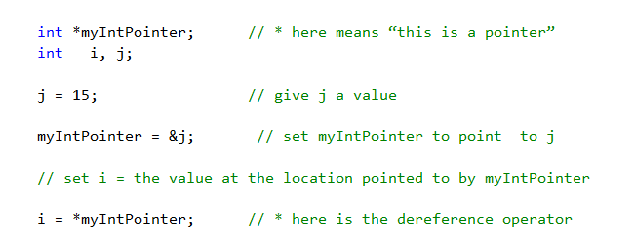
Example
i now is 15
Notes:
myInPointer = &j => the address of j

Slide 12
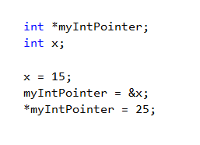
Example
x now is 25
Notes:
When assigning to *myIntPointer, we are assigning to “the guy myIntPointer is pointing to”
myIntPointer is pointing to (i.e. is holding the address of) x. So x now holds 25.

Slide 13
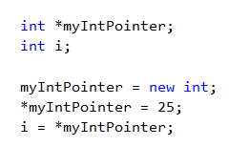
Example
i now is 25.

Slide 14
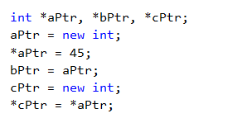
Example
What are the values of aPtr, bPtr and cPtr?
What are the values of *aPtr, *bPtr and *cPtr?
Notes:
Pointer problems can get quite complicated, but the logic is always the same, just work through it carefully.
What are the values of aPtr, bPtr and cPtr? => Don’t know, they’re memory addresses
(If you really boss VS around here, you can get it to convert aPtr, bPtr and cPtr to strings and print them. Rather despairingly, it prints “true”.)
What are the values of *aPtr, *bPtr and *cPtr? => All 45
We’ll see lots more about pointers as we go. Don’t fret about all the operators – in practice, we don’t use them all that much in Visual C++.
What is critical is that you understand that pointers don’t hold the data themselves, they hold the address of the data.
Keep clear the difference between the value of a pointer (the address it holds) and the value of the data it points to (what you get when you dereference).
If C# and Java, this difference is obscured. When you declare a class instance in these languages, the variable is actually a pointer to a class instance, not the class instance itself. But the languages allow us to talk to the pointer as though it was the instance. Frog Bob; Bob.Move(). We think that Bob is a Frog. And we are telling Bob to move. Actually, Bob is a pointer to a Frog-shaped chunk of memory. Bob just holds an address. Bob is not a Frog.
In C++ this difference is explicit. Much of the time we can ignore it, and just write our code as we always do. But when we get into complex dynamic data structures (next week) we need to keep clear what part of memory we are messing with.
For now though, we have one more syntactic issue to address...

Slide 15
Managed vs Unmanaged
.NET supports two different kinds of pointer-based data:
unmanaged (native C++)
managed (C++/CLI)
Managed objects can be moved in memory by the system while the program is running (for efficiency).
Unmanaged objects do not move.
If you create managed objects, you get automatic garbage collection.
Notes:
Just to make things a little more complex, C++ under VS has two kinds of pointers
Unmanaged don’t move and aren’t collected. That’s the “management” part.

Slide 16
Managed vs Unmanaged
All components (e.g. buttons, timers, listBoxes), system objects (e.g. Random) and user-defined class instances (e.g. Frog)
Must be accessed via pointers
Must be declared as managed.
Notes:
We’ll see examples of system objects in a minute

Slide 17
Declaring Managed Objects
Use handles (^) instead of pointers (*)
Use gcnew instead of new
Notes:
That is all
Handles (technically ‘tracking handles’) can have their values changed by the system at runtime as things are shuffled in memory
Pointers never change
‘gcnew’ means ‘garbageCollectionNew’
After that, using managed and unmanaged pointers in the code is exactly the same
In fact, even though we will technically be working with handles, we will still probably call them pointers most of the time…..

Slide 18
Managed vs Unmanaged
Unmanaged
myClass* unmanagedPtr;
unmanagedPtr = new myClass(….);
Managed
myClass^ managedPtr;
managedPtr = gcnew myClass(….)
Either way
unmanagedPtr->classMethod(…)
managedPtr->classMethod(…..)
Notes:
unmanagedPtr is a pointer to an instance of myClass. The value unManagedPtr points to will not move, and we must free its memory ourselves
managedPtr is a handle to an instance of myClass. The object managedPtr points to may move, and the system will free its memory when nobody is pointing to it.
After declaration, working with them is the same.
So, no big deal.
We will pretty much use managed pointers all the time, but you will see lots and lots of unmanaged pointers out there
anything not VS2008 or later will use *
The logic is the same, except for manual freeing of memory
When looking at unmanaged code samples, you will see a lot of “disposing” and “delete” and “free” and ~className. Those are all about freeing up memory when you are finished using it.
We will see that some more later in the paper when we have to do a little management that’s too delicate for the auto collection to take care of.

Slide 19
Today’s Practical
Component Review
Notes:
You’ll get lots of practice with pointers once we start declaring our own classes. But first, a little more warmup.
Today, we’ll have a play with GUI components, since you may not have done this in VS since Programming 2
We will be using some powerful static classes today like Image and Thread. For now, just follow the patterns given in the practical handout. We will discuss these classes in more depth as we get further into the paper.
We’ll give you the handout in a minute, but first here are some things you need to know

Slide 20
Random Number Generation
Random number generator
An instance of class Random
Random^ rGen
rGen = gcnew Random();
rGen->Next(100);
Notes:
You will recognise this approach from C#.
The only real difference is that in C++ we must use a pointer to get to an instance of the Random class.

Slide 21
Creating a Canvas
In .NET, forms don’t automatically come with a drawing surface (canvas).
You must create one.
Create an instance of the class Graphics
using namespace System::Drawing // note the ::
Graphics^ mainCanvas
NOT: mainCanvas = gcnew Graphics();
mainCanvas = CreateGraphics();
Notes:
You should also remember this from C#
This is also discussed in today’s handout
Every language and IDE has some anomalies. Don’t worry about it, just learn them.
Note that not every object exposes the CreateGraphics() method. But the form does. We usually get the form to create our canvas and then pass it around to any other objects who need it either in their constructor, or as a method parameter.
After you create the Graphics it has many lovely drawing methods that we will get to know during the term.
See today’s prac for some examples.

Slide 22
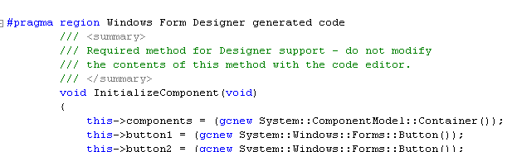
Global Variables
There are technically no global variables.
We add data properties to the Form class.
Notes:
Find that line in your Form1.h. We will discuss the whole “.h” thing next time.
Put your form data properties above that line
So, for example, in my solution to today’s practical, you will see this….

Slide 23
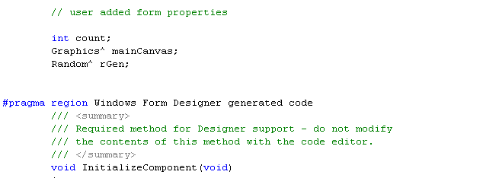
Declaring Form Data Properties
Notes:
You’ll see that you need these as you work through the prac
Remember also that declaring a pointer doesn’t create the thing, it only creates the pointer
So you need to create your objects
The best place is in the Form_Load event.
Again, in my solution you’ll see this code:

Slide 24
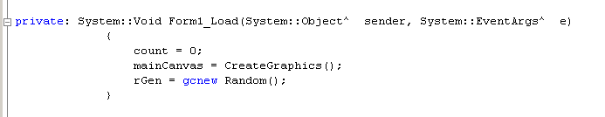
Instantiating Form Properties
Notes:
Form_Load is the default property of the form. Get its skeleton by double-clicking anywhere on the body of the form.
Do not modify the Form constructor (complex reasons we will discuss later…maybe in 3rd year)
You can now use these in any form method – button click handler, timer, etc.

